Slide 1

3Rd Semester Project
(Final Review)
Title :- Interactive Algorithm Laboratory
Version 1.0
All MCA Algorithms In one software
Supervisor Name : Dr Gaurav Pareek Sir and
Dr Kanchan Madam
Team : Vikash Singh (20MCA10050)

Slide 2

Time Schedule :-
Module Name | Reviews | Status | Start Date | End Date
Problem Understanding / Objective formulation | Shown in review 1 | Completed | 12/04/2021 | 15/04/2021
Requirement Analysis | Shown in review 1 | Completed | 15/04/2021 | 25/04/2021
Design | Shown in review 1 | Completed | 25/04/2021 | 30/04/2021
Development :- Main Page | Shown in review 1 | Completed | 1/05/2021 | 10/05/2021
Development :- Sorting Algo | Shown in review 1 | Completed | 10/05/2021 | 15/05/2021
Development :- CPU Scheduling Algo | New in Final review | Completed | 15/05/2021 | 20/05/2021
Development :- Greedy Algo (Dijkstra Algo.) | New in Final review | Completed | 20/05/2021 | 25/05/2021
Development :- Matrix multiplication | New in Final review | Completed | 25/05/2021 | 30/05/2021
Testing | New in Final review | Completed | 1/06/2021 | 4/06/2021
Documentation | New in Final review | Completed | 12/06/2021 | 14/06/2021

Slide 3
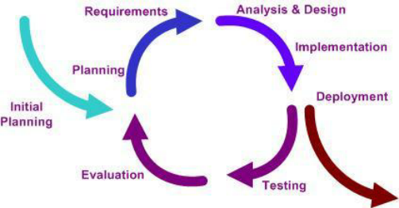
Using Iterative Software Development Model
Iteration 1 :- Sorting Algo
Iteration 2 :-
CPU Scheduling Algo
Iteration 3: Greedy Algo
Iteration 4 :Matrix Multiplication

Slide 4
Algorithm Laboratory Version 1.0
Project objective :- Algorithm Laboratory
Version 1.0 is a desktop based application developed in Java framework.
Problem:- presently students are developing algorithms in command line which does not make it very interactive.
Solution of the above problem is to developed GUI based software and implement algorithms, so that developers can understand the algorithm interactively by changing the input in GUI

Slide 5
Interactive Algorithm Laboratory Version 1.0
PROJECT OBJECTIVE :-
To develop Interactive computer science basic algorithm under one software.
To develop a software with a focus on interactivity and visualization of each step of algorithms.
To develop and facilitate the process of understanding algorithms for beginners with interaction over GUI.
To develop a study classroom usable software for educational purposes.

Slide 6
Algorithms Implemented:-
Sorting algorithms
Bubble Sort , Insertion sort , Selection sort ,
Merge Sort , Quick Sort , Heap Sort
2. CPU Scheduling algorithms
Shortest Job First,
First Come First Serve ,
Shortest Remaining Time First ,
Round Robin
3. Greedy Algorithms
Dijkstra Algorithm
4. Matrix Multiplication

Slide 7
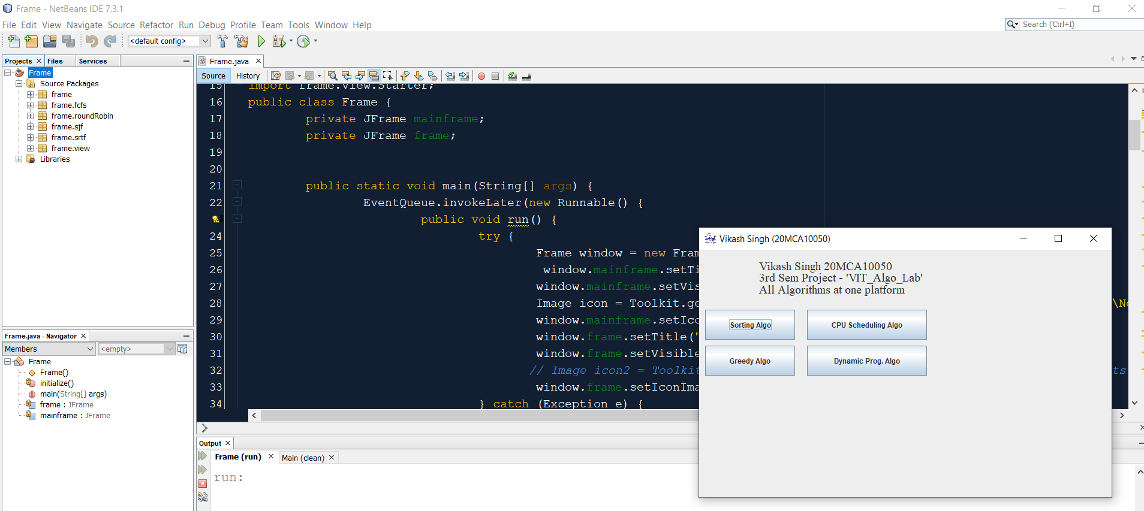
Development Environments :- Java , swing Jframes
and NetBeans 7.3.1

Slide 8
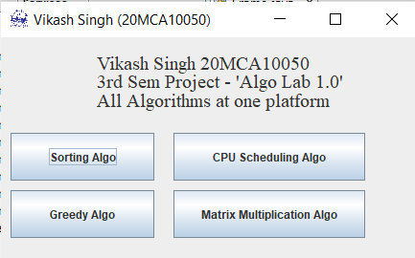
Main Page
1. When application will be launched by clicking on “RUN” button on net banes ,
following Main page will appear
2. Navigation to the specific type of algorithm can be done by clicking the buttons on the main page.
3. VIT logo and Developer name with registration number can be seen on Title Bar

Slide 9
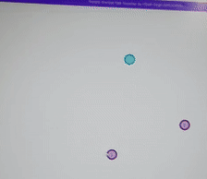
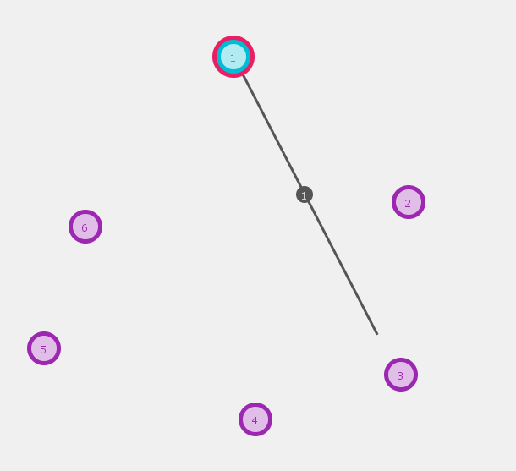
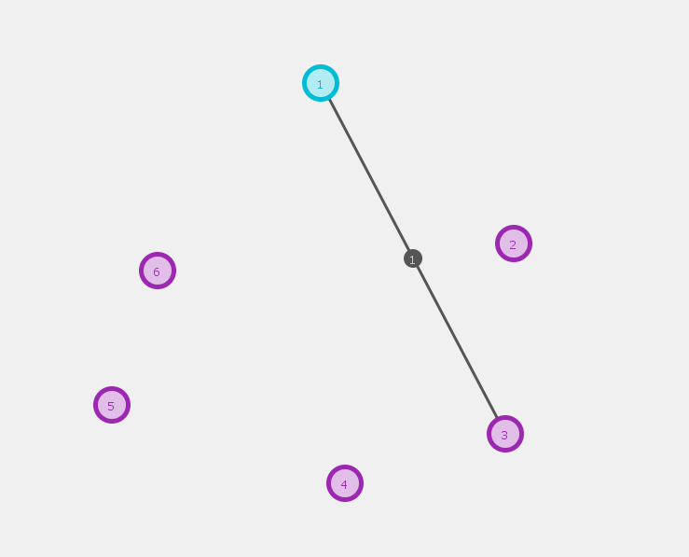
1. Interactive Dijkstra Algorithm on screen
Dijkstra's algorithm is an algorithm for
finding the shortest paths between nodes in a graph.
1. User can Draw nodes interactively on screen
2. User can Draw Edges interactively on screen
3. User can Set Starting Node interactively on screen
Input Screen
4. User can Set Destination Node interactively on screen
5. Developed module Animation in Preview mode

Slide 10
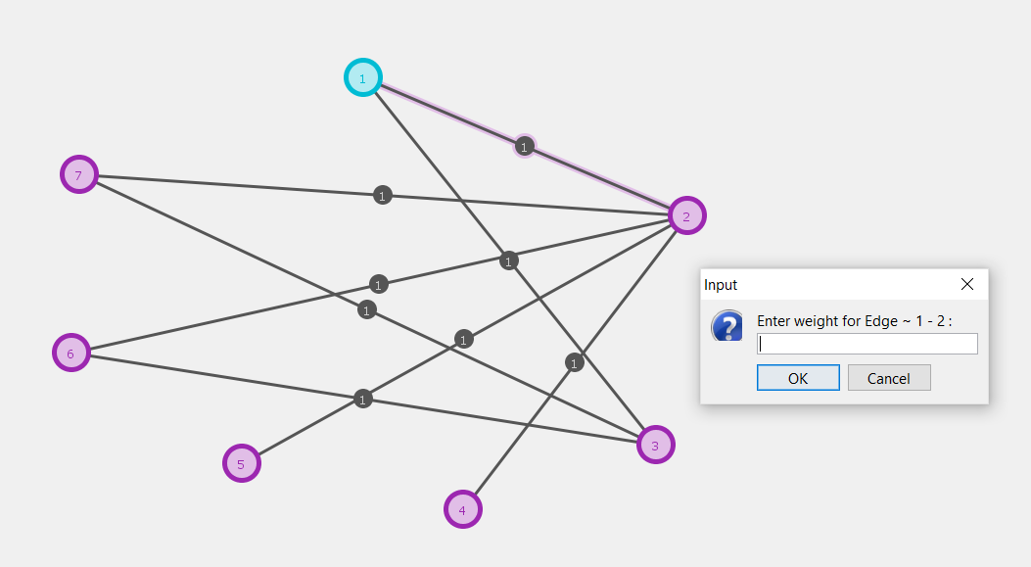
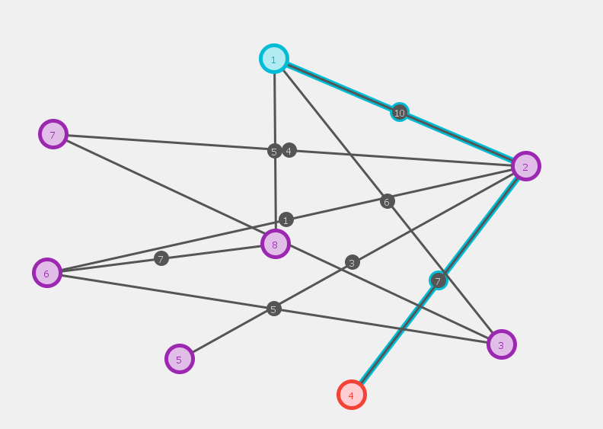
1. Interactive Dijkstra Algorithm on screen
Weight of any node can be changes by clicking on the edge INTERACTIVELY.
Shortest path will be shown with color coding of source and destination node
Edges and nodes can be moved here and there on screen itself
Output Screen
Change Weight of any node
Final shortest path

Slide 11
2. CPU Scheduling Algorithms
CPU Scheduling is a process of determining which process will own CPU for execution while another process is on hold.
The main task of CPU scheduling is to make sure that whenever the CPU remains idle, the OS at least select one of the processes available in the ready queue for execution.
The selection process will be carried out by the CPU scheduler. It selects one of the processes in memory that are ready for execution.
1. Arrival Time: Time at which the process arrives in the ready queue.
2. Burst Time: Time required by a process for CPU execution.
3. Turn Around Time: Time Difference between completion time and arrival time. Turn Around Time = Completion Time – Arrival Time
4. Waiting Time(W.T): Time Difference between turn around time and burst time. Waiting Time = Turn Around Time – Burst Time

Slide 12
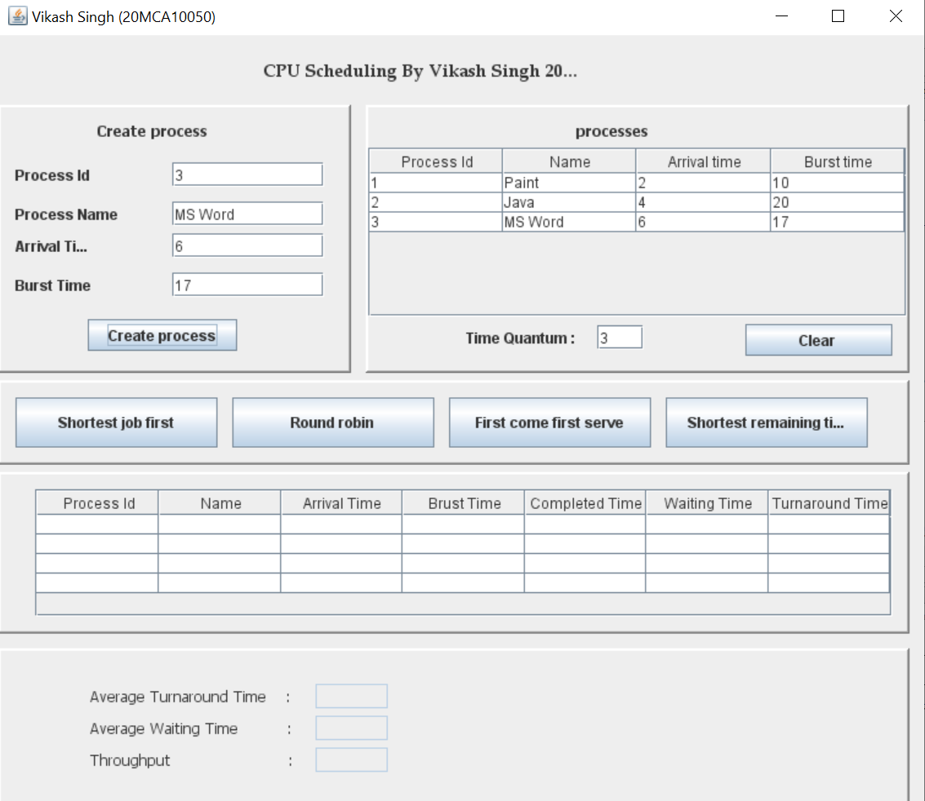
2. CPU Scheduling Algo. - Input
User can create the multiple process interactively using GUI.
User can select the various types of scheduling algorithms.
Time Quantum can be given in case of round robin algorithm.
Completion time , turn around time and waiting time will be shown in output panel.
Input Screen
1. Create Process
2. Give Time Quantum
3. Select Type
of Algorithm

Slide 13
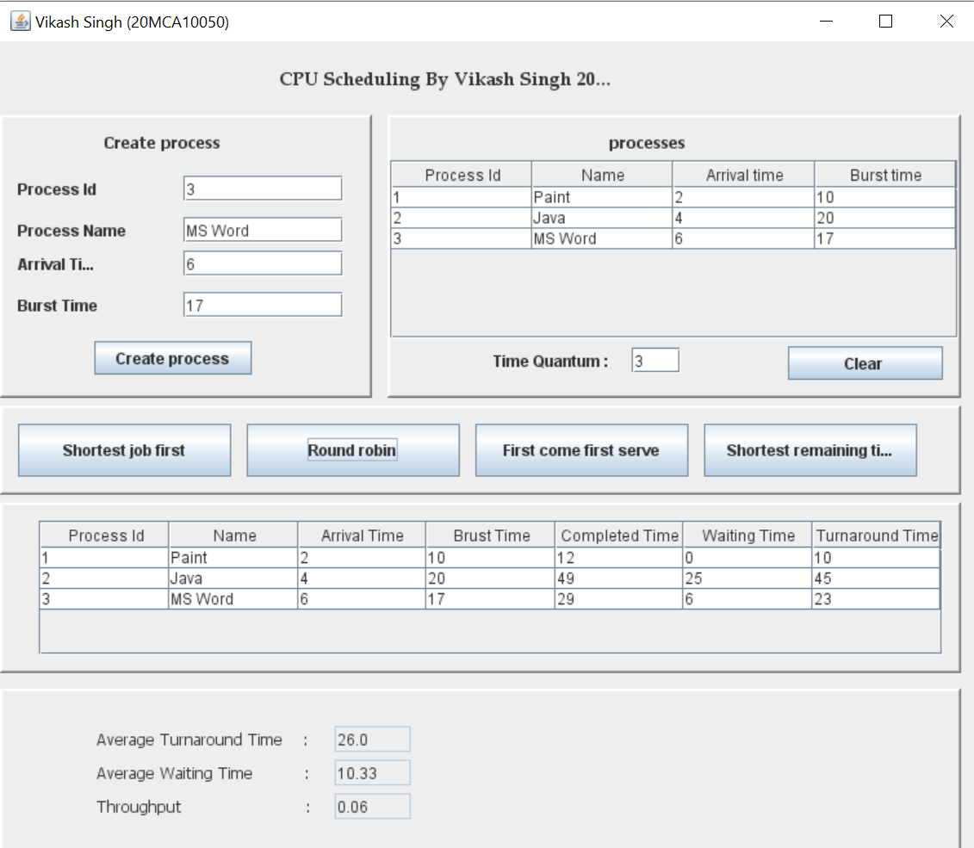
2. CPU Scheduling Algo - Output
Output Screen
4. All Process
with there
Completion time,
Waiting Time,
Turnaround time
5. Final Average Times with Overall Throughput

Slide 14
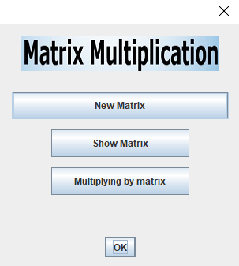
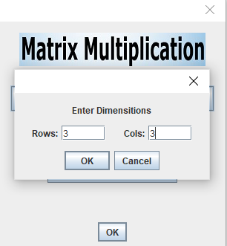
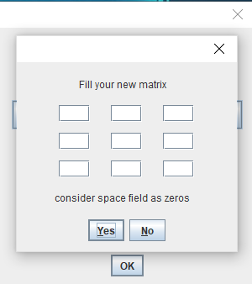
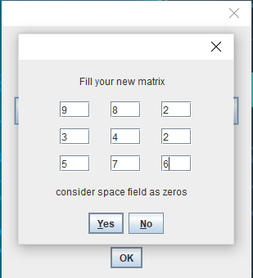
3. Matrix Multiplication
1. Add new matrix of any dimension for multiplication
2. Enter the first matrix interactively by entering values in cells
3. Option for automatic consideration of empty cells as zero value
4. Check your matrix by using Show Matrix options
Input Screen

Slide 15
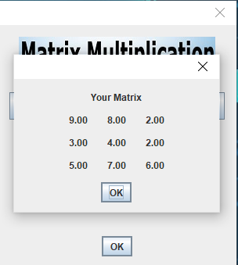
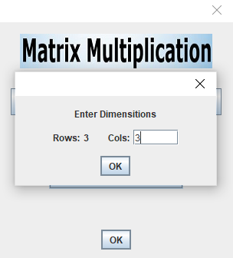
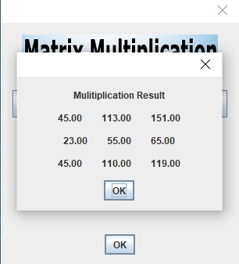
3. Matrix Multiplication
5. Enter dimension of 2nd multiplying matrix
6. Enter the second matrix interactively by entering values in cells
7. Result of multiplication can be seen on the screen
Output Screen

Slide 16
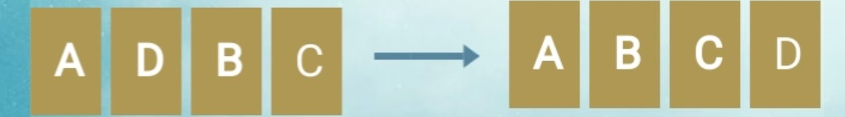
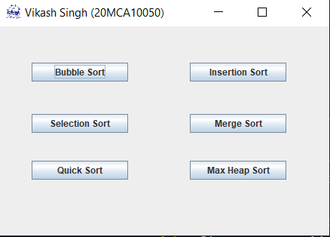
4. All Sorting Algo Implemented
Sorting Algorithm | Time Complexity |  |  | Space Complexity
 | Best Case | Average Case | Worst Case | Worst Case
Bubble Sort | Ω(N) | Θ(N²) | O(N²) | O(1)
Selection Sort | Ω(N²) | Θ(N²) | O(N²) | O(1)
Insertion Sort | Ω(N) | Θ(N²) | O(N²) | O(1)
Merge Sort | Ω(N log N) | Θ(N log N) | O(N log N) | O(N)
Heap Sort | Ω(N log N) | Θ(N log N) | O(N log N) | O(1)
Quick Sort | Ω(N log N) | Θ(N log N) | O(N²) | O(N log N)
4. User can select the type of algorithm from this page

Slide 17
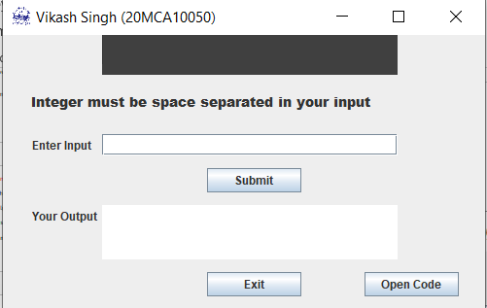
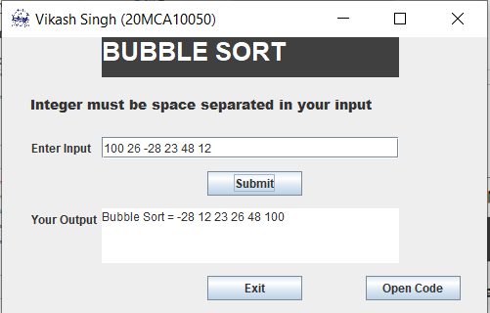

4. One Sorting Type :- Bubble Sort
One of sorting technical can be seen below
Bubble sort will accept the input by separator as space “ ”
Output will be shown in output window
Input Screen
Output Screen
2. Submit your input
3. Result of sorting

Slide 18
References
https://www.learnjavaonline.org/
VIT Operating System Slides
VIT Algorithms Slides
https://en.wikipedia.org/wiki/Dijkstra%27s_algorithm
https://en.wikipedia.org/wiki/Matrix_multiplication

Slide 19
Demo of Full Project

